Slide 1

Faculty of Business, Economics, and Informatics
Solution based on Brain-Computer Interfaces
to Mitigate Cognitive Warfare
Final Presentation - BA
Lennart Töllke
Supervisors:
Alberto Huertas, Victoria López, Sergio López

Slide 2

Structure
1 Recap
Topics & Thesis Goals
Simulation Environment
Design
2 Implementation
Simulation Model
Electromagnetic Attacks
3 Evaluation
Output Graph Interpretation
Impact of Attacks
4 Final Considerations
Summary & Conclusions
Future Work
Notes:
First
Then
After that
In the end

Slide 3
1
Recap
Notes:
1

Slide 4
Topics
Thesis Goals
Cognitive Warfare
Interference with cognition
Information (manipulate believes)
Physiologic (alter brain activity)
Electromagnetic Attacks
Radiofrequency electromagnetic radiation
Symptoms
Headaches, dizziness, memory impairment, …
Brain-Computer Interfaces (BCIs)
Direct communication between brain and device
Medical applications
Potential to mitigate attacks
Simulation of a cognitive process
Realistically
Measurable performance
Design & integration of an electromagnetic attack
Based on its underlying mechanisms
Disturbs the simulation behavior
Development of a countermeasure
Respects the capabilities of BCIs
Mitigates impact of attack
Notes:
What is CW? Incorporates practices that interfere with the Cognition of the enemy
The last goal was to explore the development of a countermeasure

Slide 5
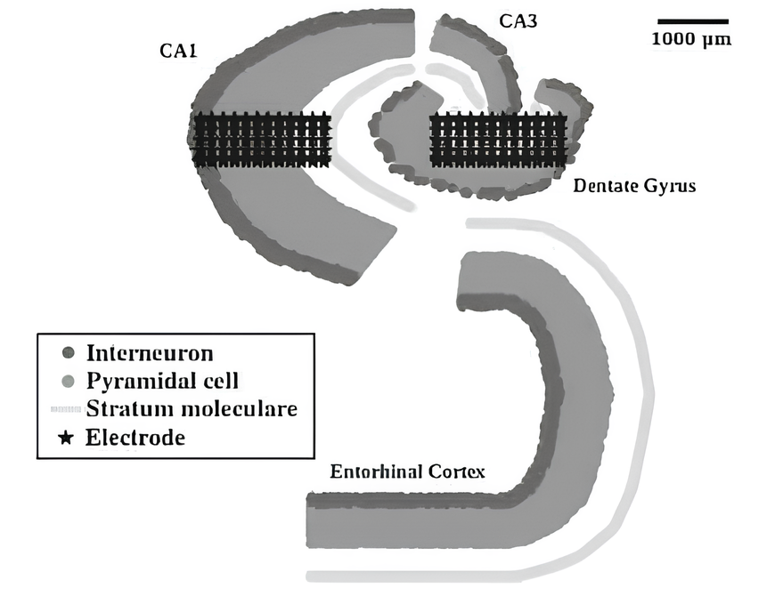
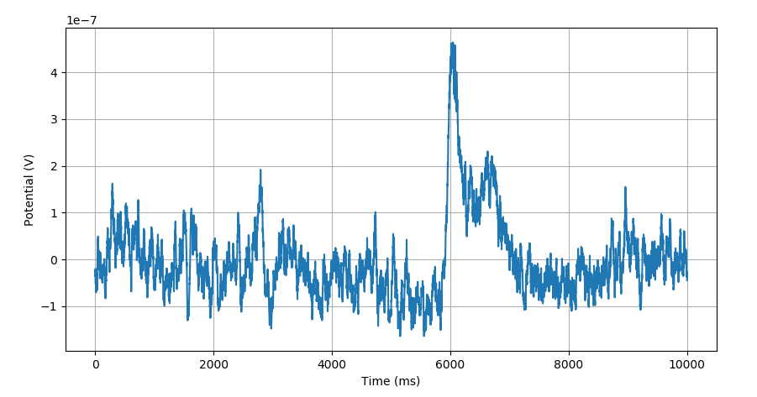
Simulation Environment
Simulator
Brian2
Mathematical abstractions
Allows for efficient simulation of spiking neural networks
Simulation Model
Large network of hippocampus
Anatomically accurate structure
Relation to memory consolidation
Activity pattern
Simulation process
Input
Necessary parameter
Network Activity
Calculated with model equations
Output
LFP recordings
Neuron population activity
Represents external brain activity
Notes:
First goal was met and builds foundation for rest.
-> Followingly short overview of environment
Necessary parameter -> to produce relevant activity
LFP recordings -> extracellular electrical potential, around electrode

Slide 6
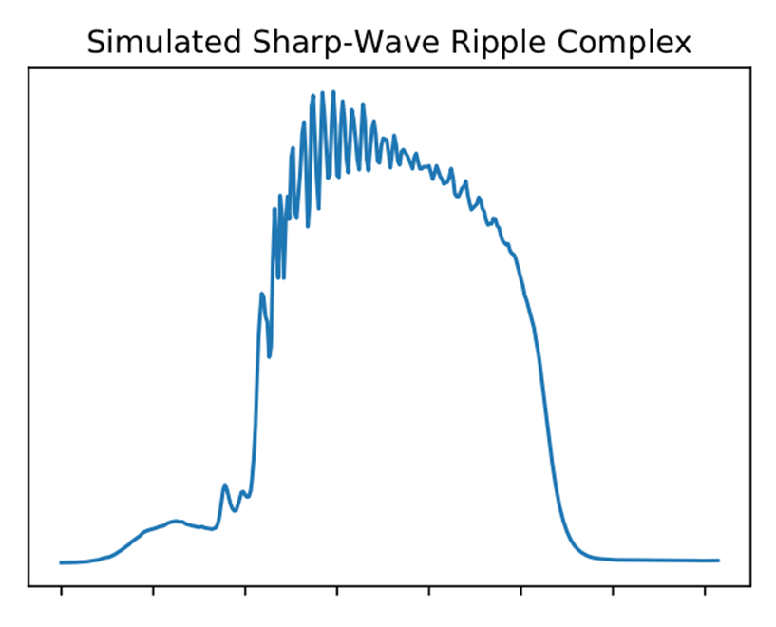
Design: Simulation Model
Input
Synthetically generated
Following a function
Based on real brain recordings
More realistic
EEG files
Output Analysis
To retrieve measure for memory performance
Sharp Wave Ripples
Sharp Wave
With superimposed ripples
Synchronous neuron activity with high frequency
Associated with memory consolidation

Slide 7

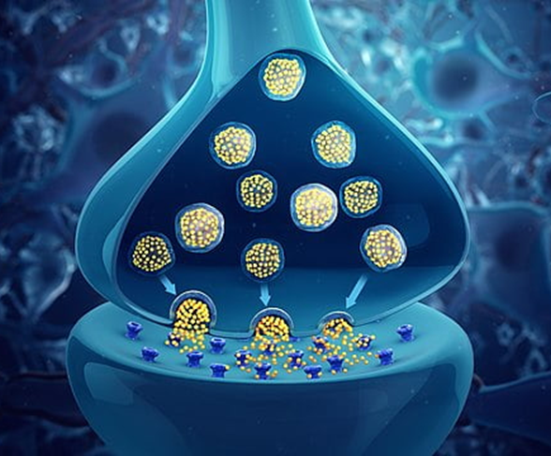
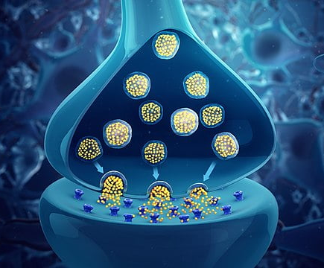
Design: Electromagnetic Attacks
Neurotransmitter Changes
Specifically, Acetylcholine
Shows increased levels
Effects network conductance
Structural Damage
Can destroy neurons
Affects Synapses
Reducing their conductance
Full Attack
Combination of all alterations
Most realistic scenario
Notes:
Approach
- Substituted with literature on electromagnetic radiation
- Identified brain alterations
- Attacks represent different types of alterations

Slide 8
2
Implementation
Notes:
10

Slide 9
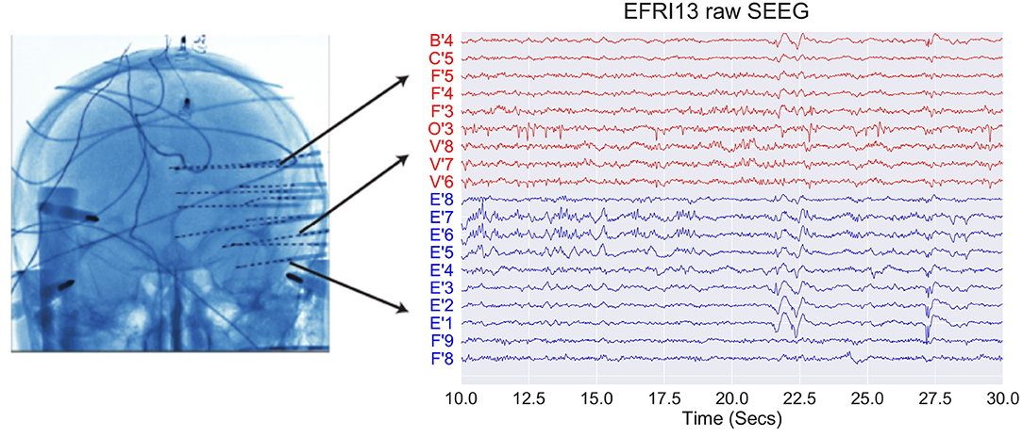
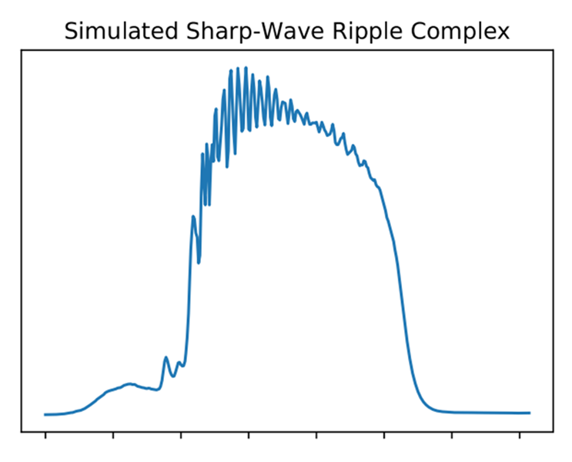
Implementation: Simulation Model
Input
Initially explored synthetic input
Later received EEG files
Automatic processing and integration
Voltage recordings in stimulation frequencies
Output Analysis
Sharp wave detection
With peak and boundary conditions
Frequency analysis
Identifying peak frequency
Validates in ripple band
Collects loads of data
Notes:
Changes values of affected model equations (followingly also network activity)

Slide 10
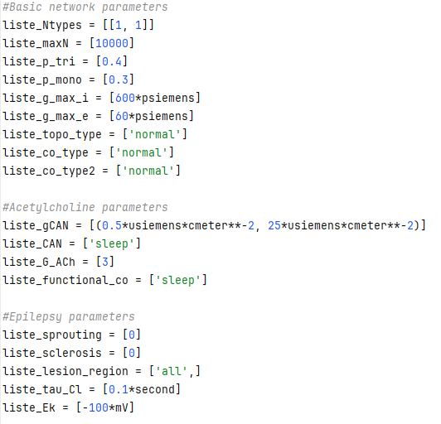
Implementation: Electromagnetic Attack
Integration facilitated by model
Large parameter space
Allowed representation of identified mechanisms
Represents the brain state after an attack
Parameters
Neurotransmitter changes
gCAN: Ion channel conductance
G_ACh: Complex alteration of synaptic conductances depending on area
Structural damage
maxN: Amount of Neurons
g_max_e: general excitatory synaptic conductances

Slide 11
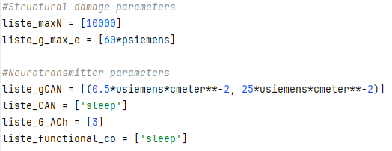
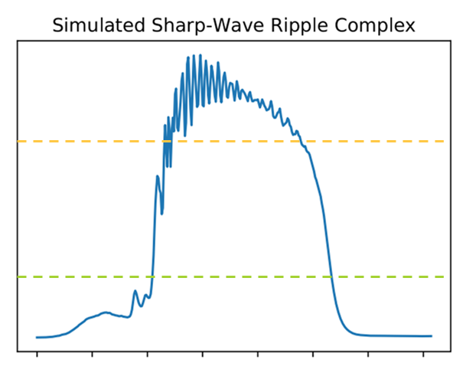
Implementation: Overview
Resulting simulation process:
Input
Necessary parameter
Network Activity
Calculated with model equations
Output
LFP recordings
Neuron population activity
Represents external brain activity
Real brain recordings
Electromagnetic attacks
Memory consolidation
Notes:
Based on simulation process diagram
External brain activity is represented by actual recordings from there
Resulting Network activity calculations were altered to represent the attack impact
LFP recordings are analysed on sharp wave ripples to measure memory performance

Slide 12
3
Evaluation
Notes:
14-15
Even though, also some evaluations regarding input and output analysis were performed, Focus on Electromagnetic attacks

Slide 13
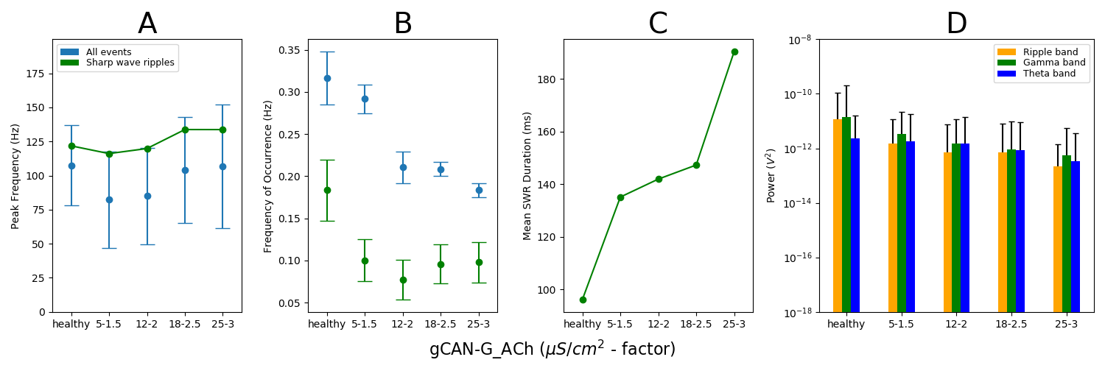
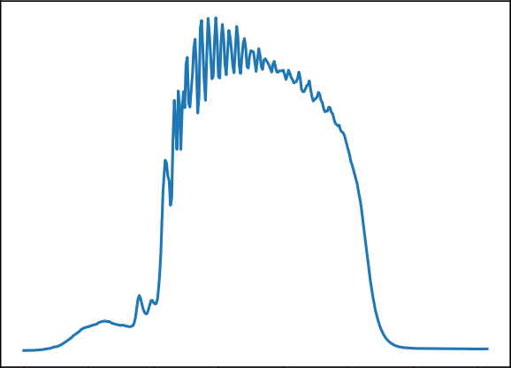
Evaluation: Output Graph Interpretation
Strongest Oscillation Frequency
Sharp Wave Occurrence
Frequency
Sharp Wave Ripple Duration
Oscillation Power
Notes:
All sub plots are structured the same:
Outputs of a healthy simulation on the left
Followed by outputs, produced with attack related alterations
increase with intensity to the right
Further, in Blue, values of all detected events / sharp waves
green those that qualify as sharp wave ripples (related to memory consolidation)

Slide 14
Evaluation: Neurotransmitter Changes
Most relevant observations
Decrease in sharp wave ripple occurrences
Reduction of oscillation power

Slide 15
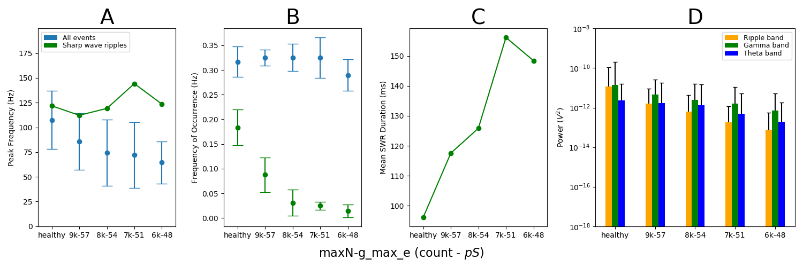
Evaluation: Structural damage
Most relevant observations
Similar reduction in occurrences and power
Large reduction of peak frequency

Slide 16
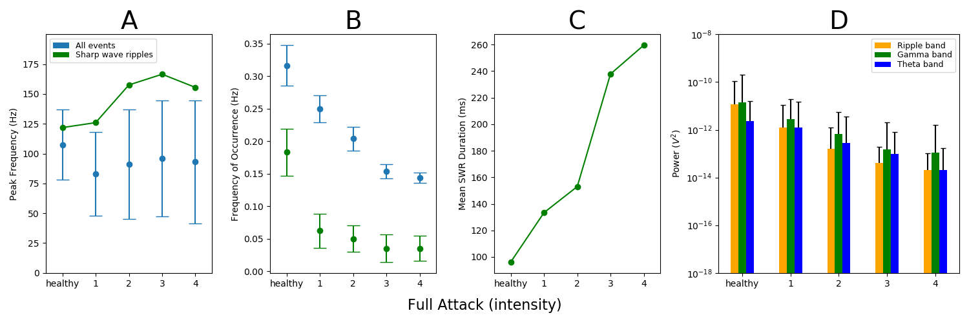
Evaluation: Full Attack
Most relevant observations
Strong deviation from healthy values in all parameters
Large impact with low intensity
Notes:
Combination of both previous alterations

Slide 17
4
Final Considerations
Notes:
19

Slide 18
Final Considerations
Summary & Conclusions
Simulation model
Memory consolidation
Anatomically accurate topology & EEG files
Electromagnetic attacks
Potential mechanisms identified & simulated
Impaired memory consolidation
Aligns with reported symptoms
Countermeasure
Clarified impact of attacks on brain
Capabilities of BCIs explored
Future Work
Development of a countermeasure
Based on the contributions of this work
Electromagnetic attacks
Further mechanisms
Simulation model
Realistic synthetic input generation
Automated sharp wave ripple detection

Slide 19
Thank you for your Attention!

